Slide 1
Feature detection and matching - Lines

Slide 2
Objectives
Learn the basics of Line Detection
Learn the most popular line detectors: Hough transform.
Learn the application of convolution-based techniques in line detection
Applications of line detection in image processing

Slide 3
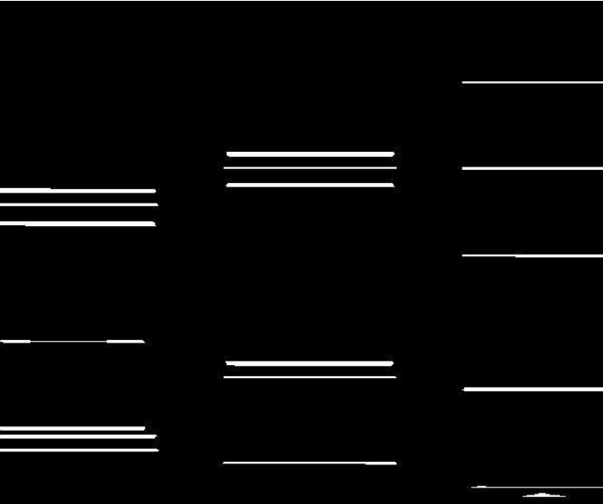

What is Line detection?
Line detection is an algorithm that takes a collection of n edge points and finds all the lines on which these edge points lie.
Two types of techniques:
The Hough transform
Convolution-based techniques
Notes:
These points where the image brightness varies sharply are called the edges (or boundaries) of the image.

Slide 4

Line detection Steps
The lane detection pipeline follows these steps:
Pre-process image using grayscale and Gaussian blur.
Apply canny edge detection to the image.
Apply masking region to the image.
Apply Hough transform to the image.
Extrapolate the lines found in the Hough transform to construct the left and right lane lines.

Slide 5

Line detection - Hough transform
It is used to recognize complex lines in photographs.
For the Hough Transform algorithm, it is crucial to perform edge detection first to produce an edge image which will then be used as input into the algorithm.
The purpose of the technique is to find imperfect instances of objects within a certain class of shapes by a voting procedure.
Now day, the Hough transform has been extended to identifying positions of arbitrary shapes, most commonly circles or ellipses.

Slide 6
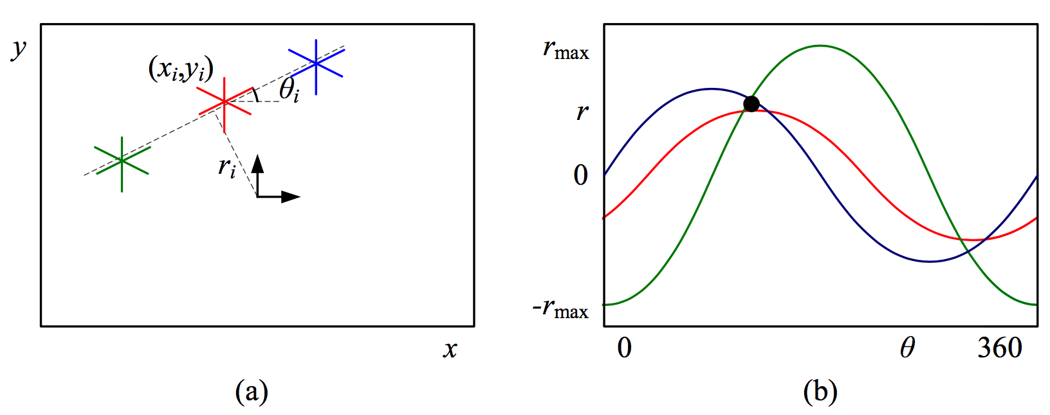
Line detection - Hough transform
Each edge point votes for all possible lines passing through it, and lines corresponding to high accumulator or bin values are examined for potential line fits
Notes:
Oriented Hough transform: (a) an edgel re-parameterized in polar (r, θ) coor- dinates, with nˆi = (cos θi, sin θi) and ri = nˆi · xi; (b) (r, θ) accumulator array, showing the votes for the three edgels marked in red, green, and blue

Slide 7
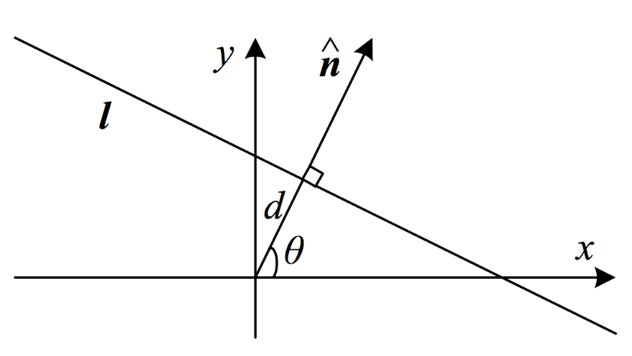
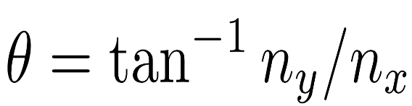
Line detection - Hough transform
Before we can vote for line hypotheses, we must first choose a suitable representation
The normal-distance (nˆ , d) parameterization for a line.
To obtain a minimal two-parameter representation for lines, we convert the normal vector into an angle
Notes:
2D line equation expressed in terms of the normal nˆ and distance to the origin d
The range of possible (θ, d) values is [−180◦, 180◦] × [−√2, √2], assuming that we are using normalized pixel coordinates (2.61) that lie in [−1, 1]

Slide 8
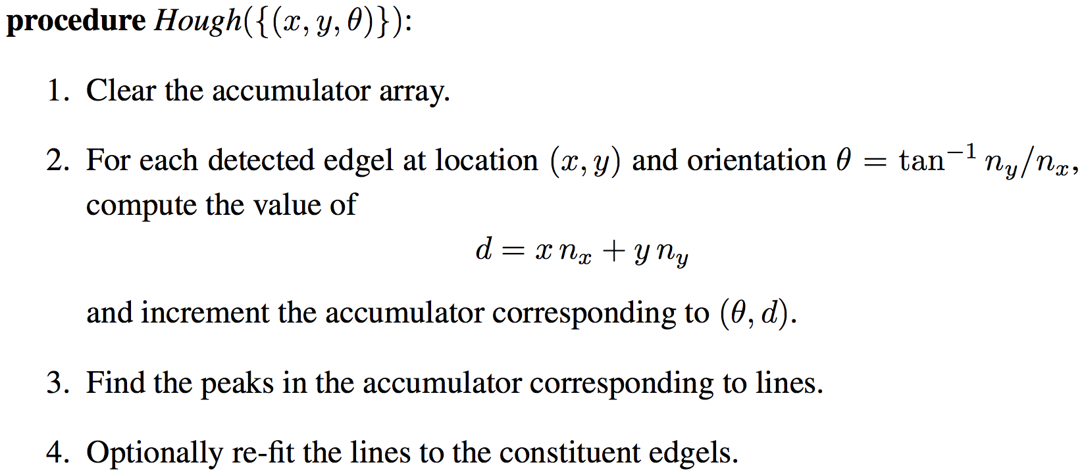
Line detection - Hough transform
Notes:
Outline of a Hough transform algorithm based on oriented edge segments.

Slide 9
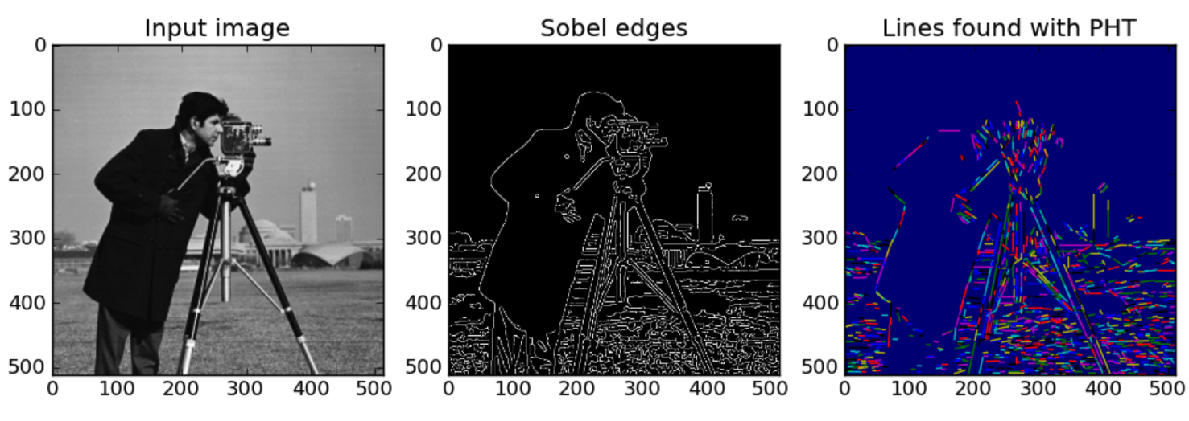
Line detection - Hough transform

Slide 10

Line detection - Convolution based technique
A convolution-based technique that produces an image description of the thin lines in an input image
In a convolution-based technique, the line detector operator consists of a convolution mask tuned to detect the presence of lines of a particular width n and a θ orientation
Four convolution masks
detect horizontal lines
detect vertical lines
detect oblique (+45 degrees) lines
detect oblique (−45 degrees) lines

Slide 11

Line detection - Convolution based technique
Horizontal mask(R1)
Vertical (R3)
-1 | -1 | -1
2 | 2 | 2
-1 | -1 | -1
-1 | 2 | -1
-1 | 2 | -1
-1 | 2 | -1
Oblique (+45 degrees)(R2)
Oblique (−45 degrees)(R4)
-1 | -1 | 2
-1 | 2 | -1
2 | -1 | -1
2 | -1 | -1
-1 | 2 | -1
-1 | -1 | 2
Notes:
Here are the four convolution masks to detect horizontal, vertical, oblique (+45 degrees), and oblique (−45 degrees) lines in an image.

Slide 12

Line detection - Convolution based technique
These masks above are tuned for light lines against a dark background, and would give a big negative response to dark lines against a light background.
If you are only interested in detecting dark lines against a light background, then you should negate the mask values.
Alternatively, you might be interested in either kind of line, in which case, you could take the absolute value of the convolution output.

Slide 13
Line detection - Convolution based technique
If Ri denotes the response of kernel i, we can apply each of these kernels across an image, and for any particular point, if Ri>Rj for all i # j that point is more likely to contain a line whose orientation (and width) corresponds to that of kernel i.
One usually thresholds Ri to eliminate weak lines corresponding to edges and other features with intensity gradients that have a different scale than the desired line width.
In order to find complete lines, one must join together line fragments, e.g., with an edge tracking operator.

Slide 14
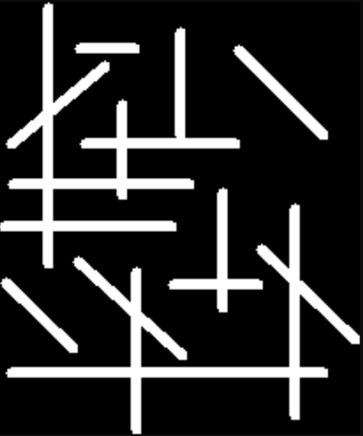
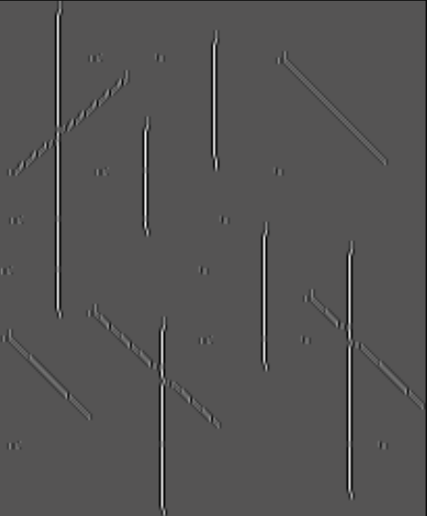


Line detection - Convolution based technique
Original image
vertical kernel
the oblique 45 degree
the oblique 135 degree
Notes:
Here are the four convolution masks to detect horizontal, vertical, oblique (+45 degrees), and oblique (−45 degrees) lines in an image.

Slide 15
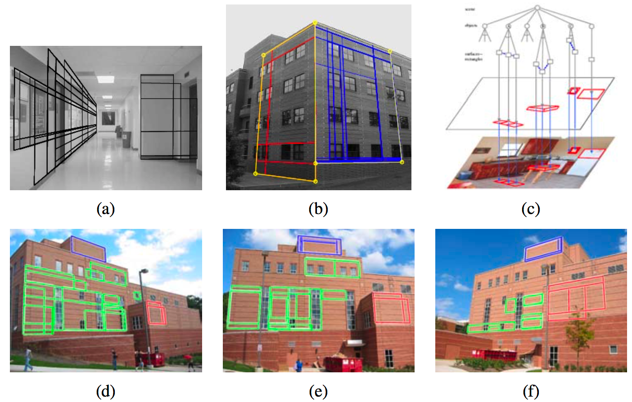
Application: Rectangle detection
Notes:
Rectangle detection: (a) indoor corridor and (b) building exterior with grouped facades (Kosˇecka ́ and Zhang 2005) ⃝c 2005 Elsevier; (c) grammar-based recognition (Han and Zhu 2005) ⃝c 2005 IEEE; (d–f) rectangle matching using a plane sweep algorithm (Micˇusˇ`ık, Wildenauer, and Kosˇecka ́ 2008) ⃝c 2008 IEEE.

Slide 16
Summary
Learn the basics of Line Detection
Learn the most popular line detectors: Hough transform.
Learn the application of convolution-based techniques in line detection
Applications of line detection in image processing

